Slide 1
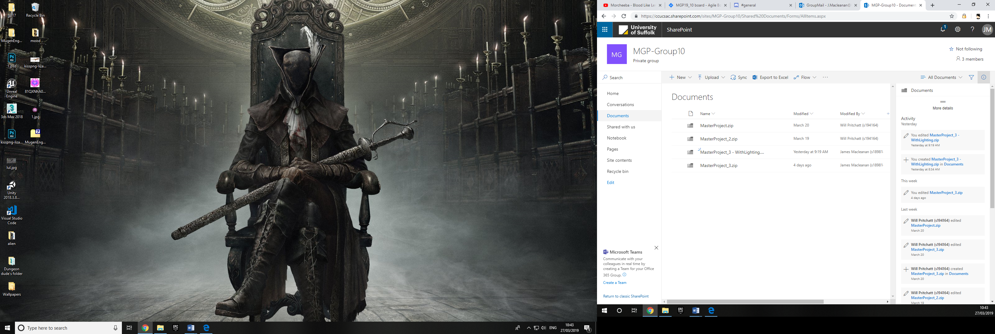
All project downloads have been mentioned in external communications. Whenever it says “you” it means James Macleanan.

